Slide 1
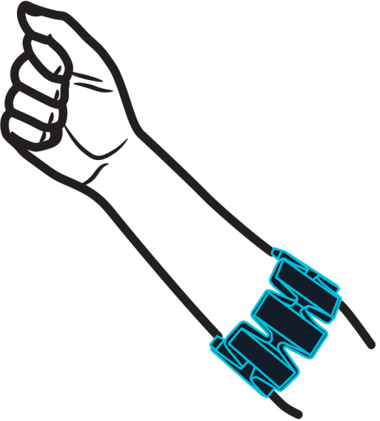
MYO – Gallery
Project by : Siddhant Jaiswal
Saurabh Bindal

Slide 2
Goal
To develop a Gallery Application in Android
To use Myo Arm Controller to control the Gallery app with Gesture motions
Example : Selecting an Image from a list of Images, Zooming in and out of a image.

Slide 3

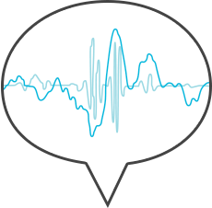
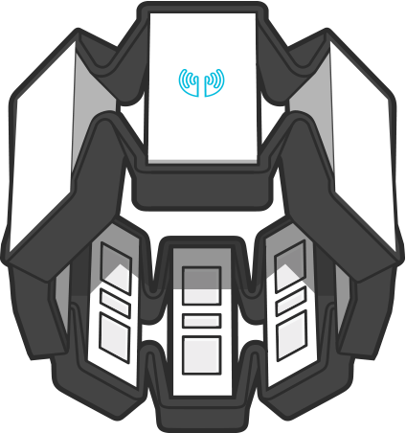
What is MYO ?
The Myo armband reads the electrical activity of your muscles and the motion of your arm to let you wirelessly control technology with hand gestures.

Slide 4
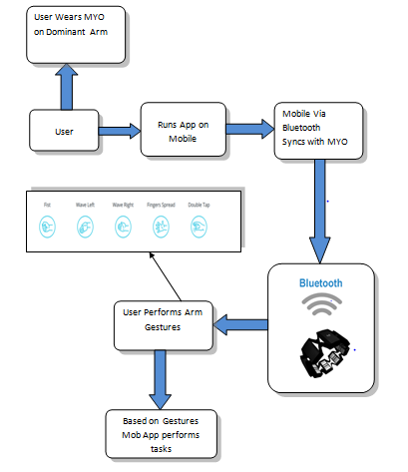
Work Flow of the Application

Slide 5
Picture Gallery
Features in Galley app configured with Myo
Sliding to Left
Sliding to Right
Selecting an Image
Zoom in an Image
Zoom out of an Image

Slide 6

Demo of Myo Working

Slide 7
Screen Recording of App Running

Slide 8
Conclusion :
After testing MYO with 5 different users on our Gallery app
(excluding us) .
* It take 2-3 mins for MYO to sync in with a new User
* We found the MYO to be accurate at reading gestures 75% of the time
* Some gestures like spread fingers (zoom in gallery) was hard to detect more 50% of the time
Thank You…

